Slide 1

Who commits suicide?
Cara You
Math 4840-904
Independent Study
Dr. French
https://www.ucg.org/bible-study-tools/bible-questions-and-answers/what-does-the-bible-say-about-someone-who-commits-suicide

Slide 2
Structure
Statistics about suicide
Variables and predictions
Exploring the data
Model and assumptions
Assumption checking
Interpretations and conclusion
Improvement

Slide 3
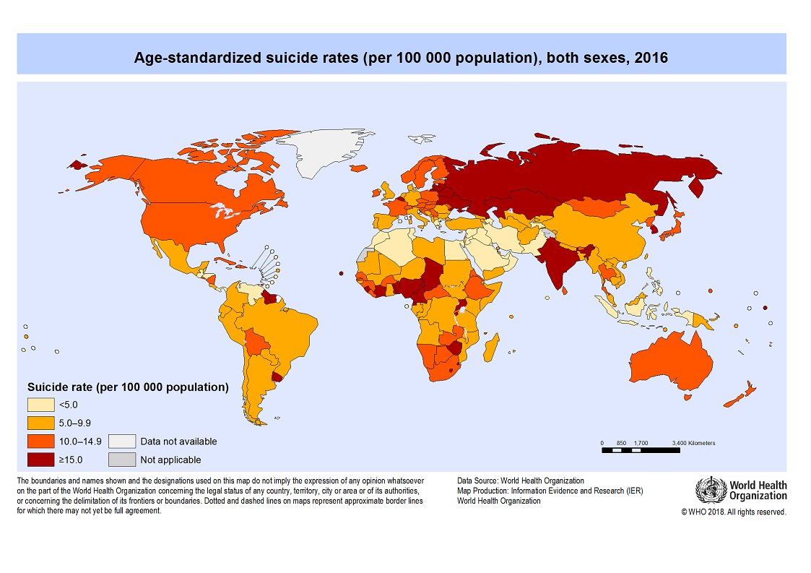
Statistics about suicide
800 000 people per year
2nd leading cause of death among 15–29-year-olds
A global phenomenon
Only 38 countries have a national strategy
Eastern Europe and East Asia, the highest

Slide 4
Variables and predictions

Slide 5
Variables and predictions
Suicide Rates Overview 1985 to 2016 from the World Health Organization (WHO, 2018).
Obtained from Kaggle (Rusty 2018, December 01).
The data compares socio-economic information with suicide rates by year and country.

Slide 6
Variables and predictions
12 variables in the raw data: country, year, sex, age, suicide_number, population, suicides/ 100k pop, county-year, HDI for year, gdp_for_year ($), gdp_per_capita ($), and generation
1985-2016
15-24 years, 25-34 years, 35-54 years, 55-74 years, and 75+ years
“Albania1985”
Human Development Index
G.I. Generation, Silent, Boomers, Generation X, Millennials, and Generation Z

Slide 7

Variables and predictions
This paper aims at discovering the important candidate variables and measuring their impacts for suicide count in order to make suggestions on suicide prevention in the future.
https://www.nsvrc.org/blogs/preventionista/community-level-prevention

Slide 8
Literature review
There is a strong negative correlation between suicide rates and GPD per capita (Fountoulakis, Konstantinos N., et al. ,2014).
Males were between 1.7 and 2.1 times more likely to commit suicide than females in 2015 (Värnik, P, March 2012).
Suicide rates have increased by 60% globally in the last 45 years (WHO, 2018).

Slide 9
Variables and predictions
We predict that higher GDP is associated with lower suicide count.
We predict that males will commit suicide of a rate triple that of females.
We predict that there is an upward trend for suicide rate over time, meaning that for every additional year, suicide rate increases.

Slide 10
Exploring the data

Slide 11
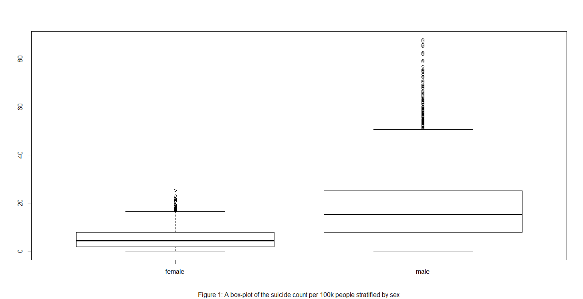
suicide rate per 100k people by sex
Males typically have larger values
Both have longer upper whiskers than lower whiskers

Slide 12
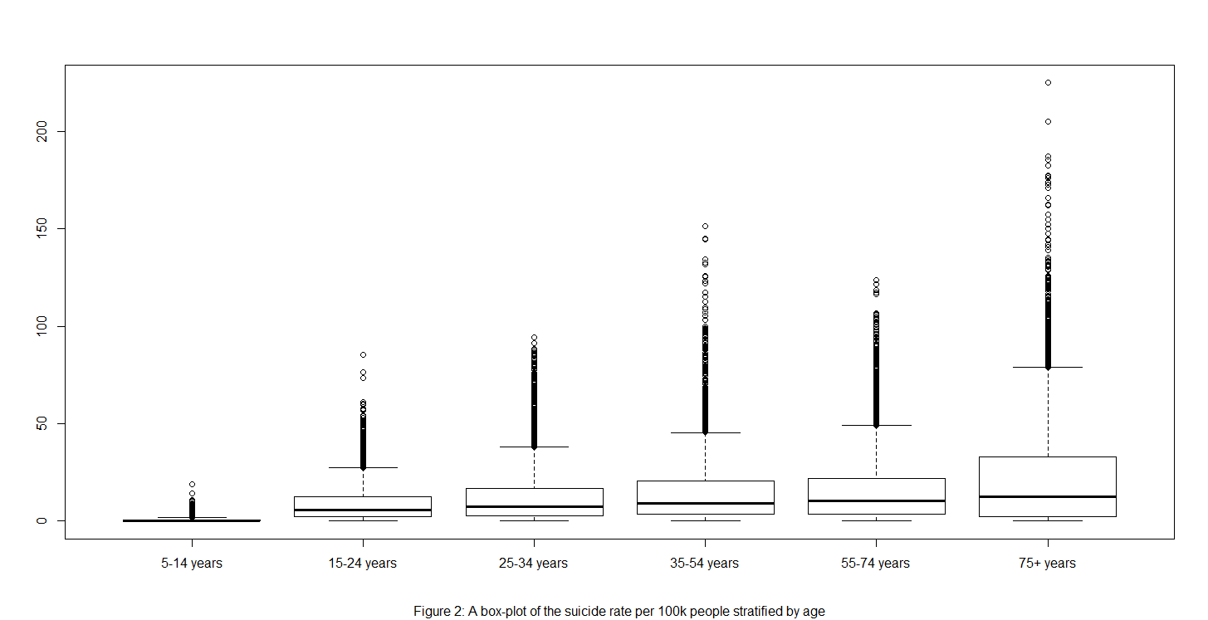
suicide rate per 100k people by age
Higher age is associated with higher suicide rates
75+ years: most varied second to third quartile and in the upper whisker, highest amount of extremely large suicide rates
2nd most varied: 35 to 54 years group

Slide 13
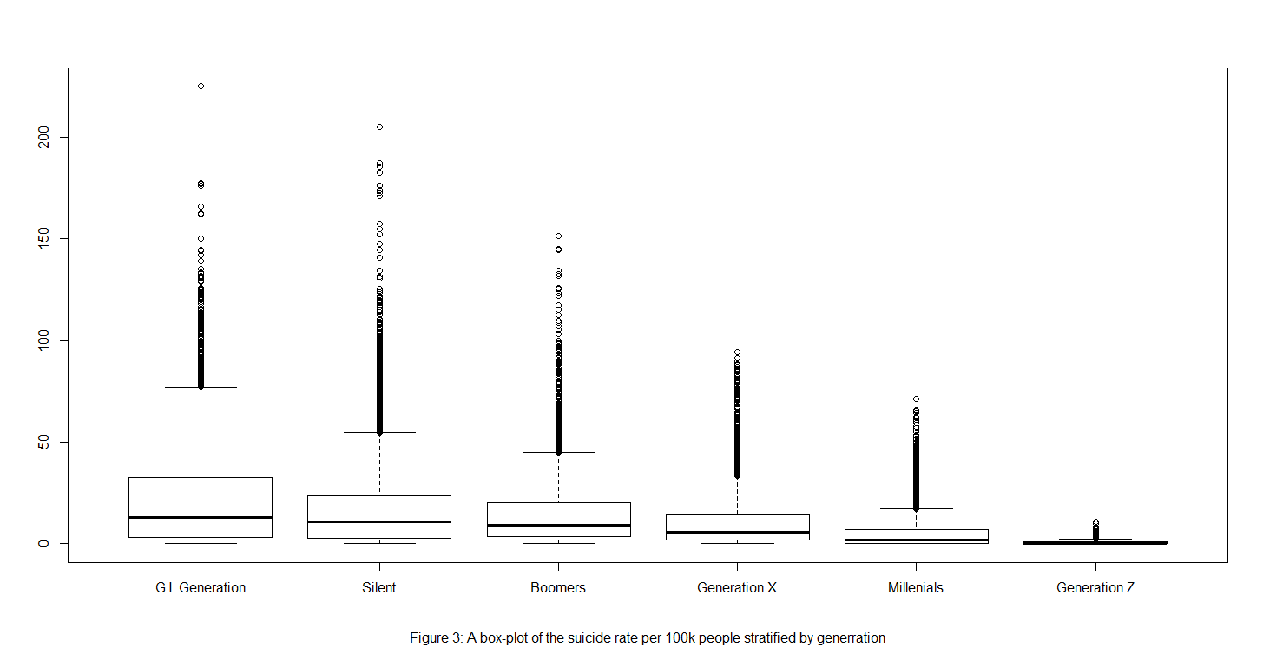
suicide rate per 100k people by generation
Older generations are associated with larger suicide rates

Slide 14
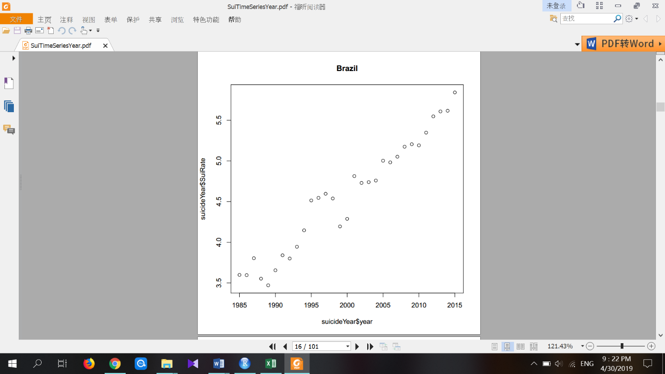
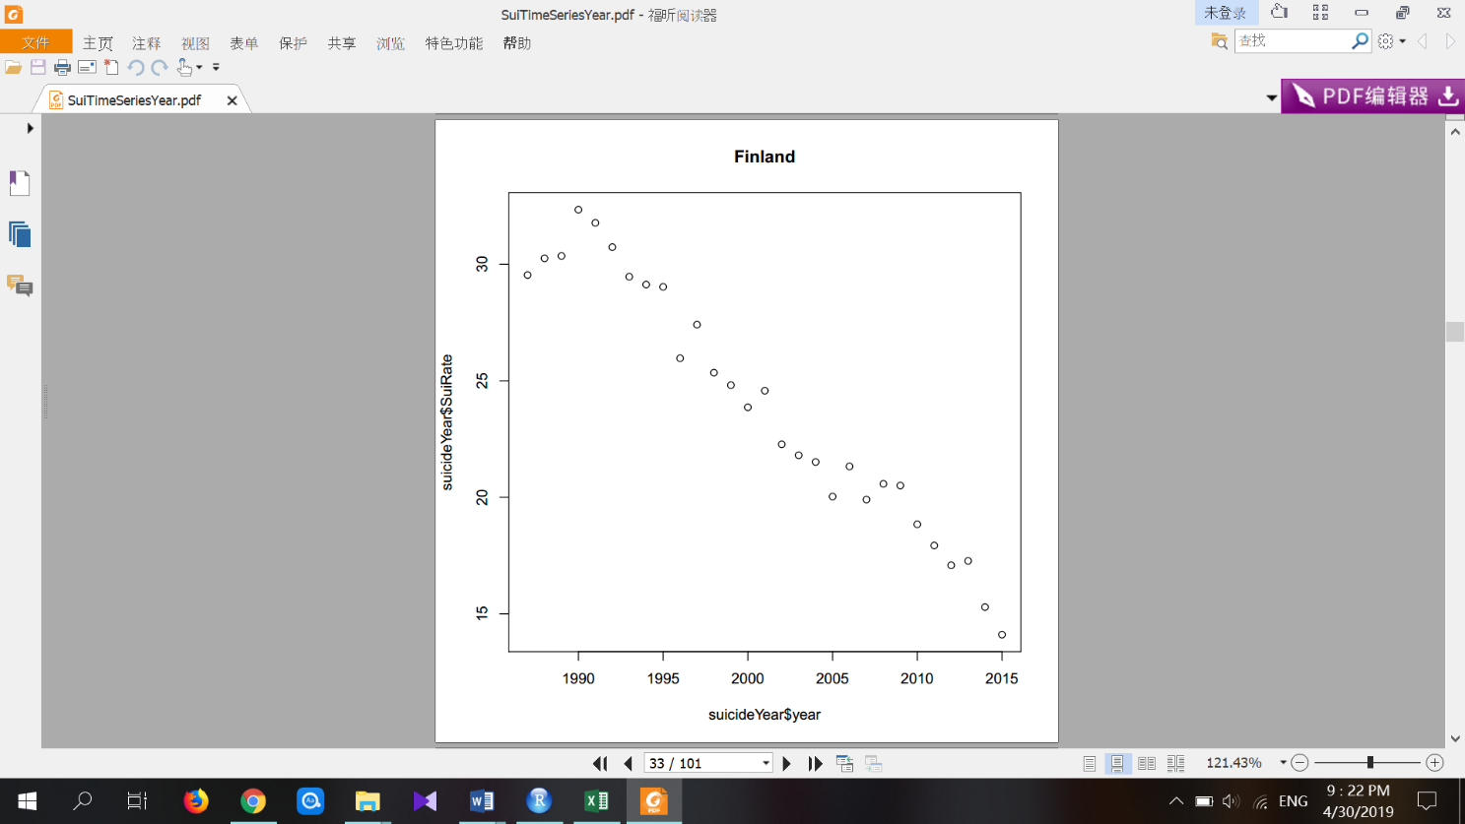

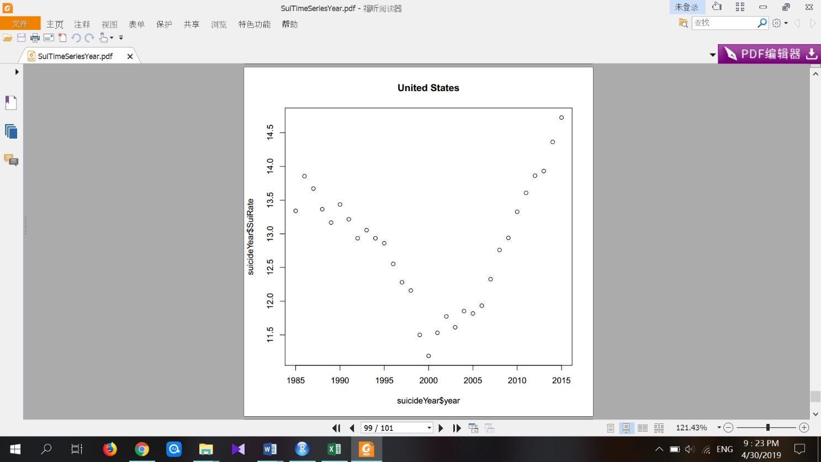
time series of suicide rate per 100k people for varies countries

Slide 15
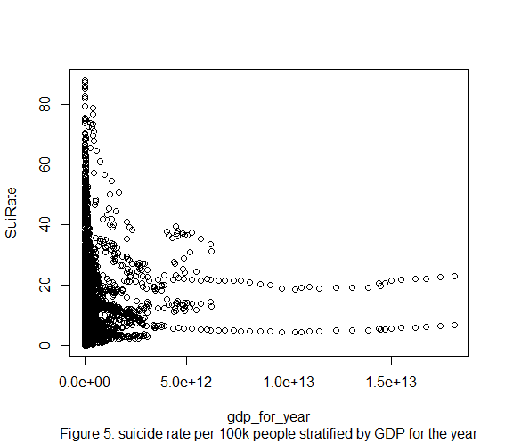
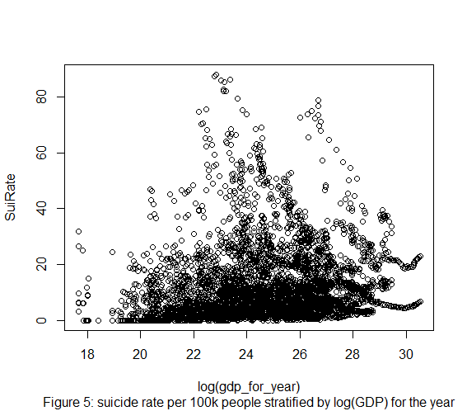
suicide rate per 100k people by GDP

Slide 16
Model and assumptions

Slide 17
Model and assumptions

Slide 18
GLM for Poisson data
Typical linear model is not appropriate for the suicide data:
The suicide data are count data. Therefore, the response variable is not continuous.
The variance of the suicide data is unlikely to be constant, as count data typically has larger variability for larger counts.

Slide 19
GLM for Poisson data
Generalized linear models (GLM) cover both situations by allowing for response variables that have non-normal distributions other than simply normal distributions, and for the link function to vary linearly with the predicted values.
Therefore, GLM for Poisson data is suitable for the suicide data.

Slide 20
GLM for Poisson data
There are three components of a GLM:
The random component, the linear predictor, and the link function

Slide 21
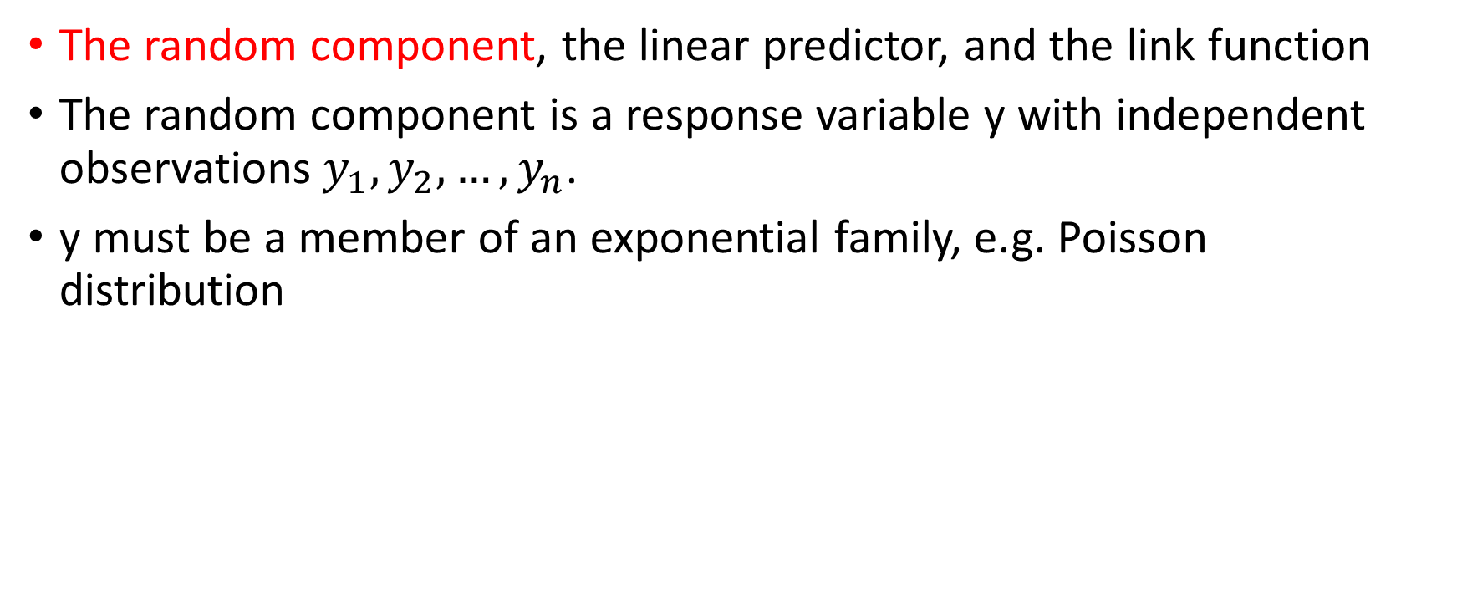
GLM for Poisson data
The random component, the linear predictor, and the link function
The random component is a response variable y with independent observations$y_{1}, y_{2},…,y_{n}$.
y must be a member of an exponential family, e.g. Poisson distribution

Slide 22
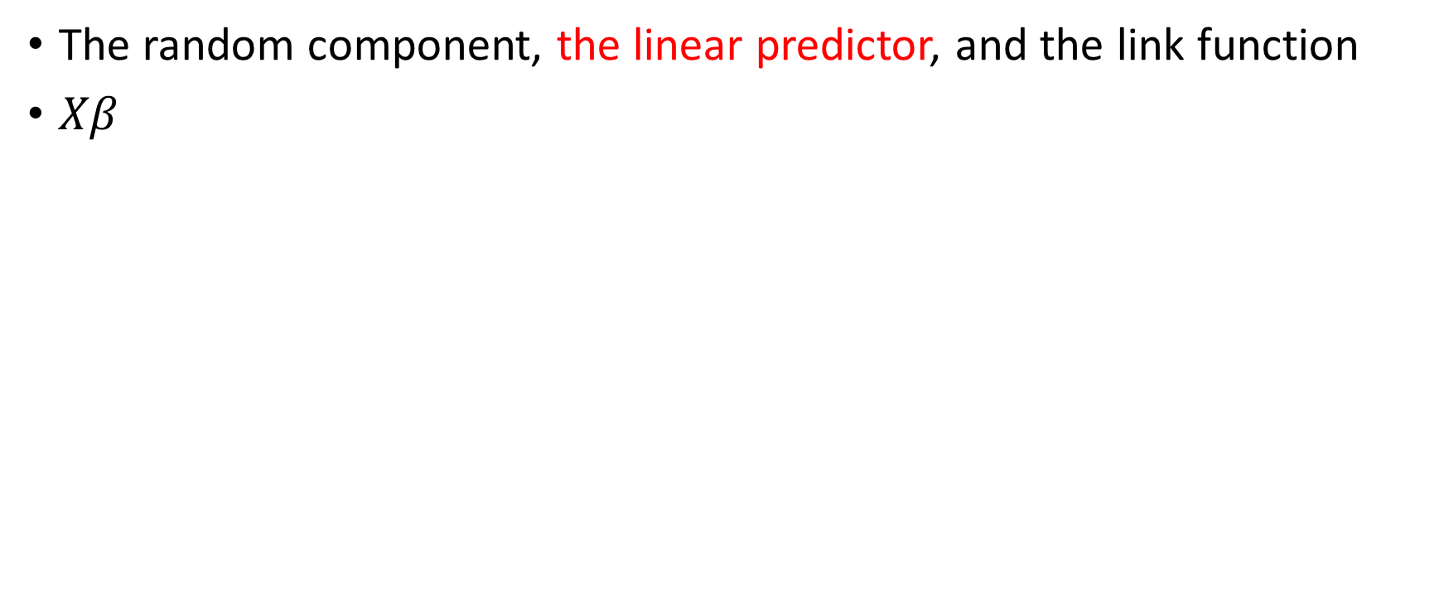
GLM for Poisson data
The random component, the linear predictor, and the link function
$Xβ$

Slide 23
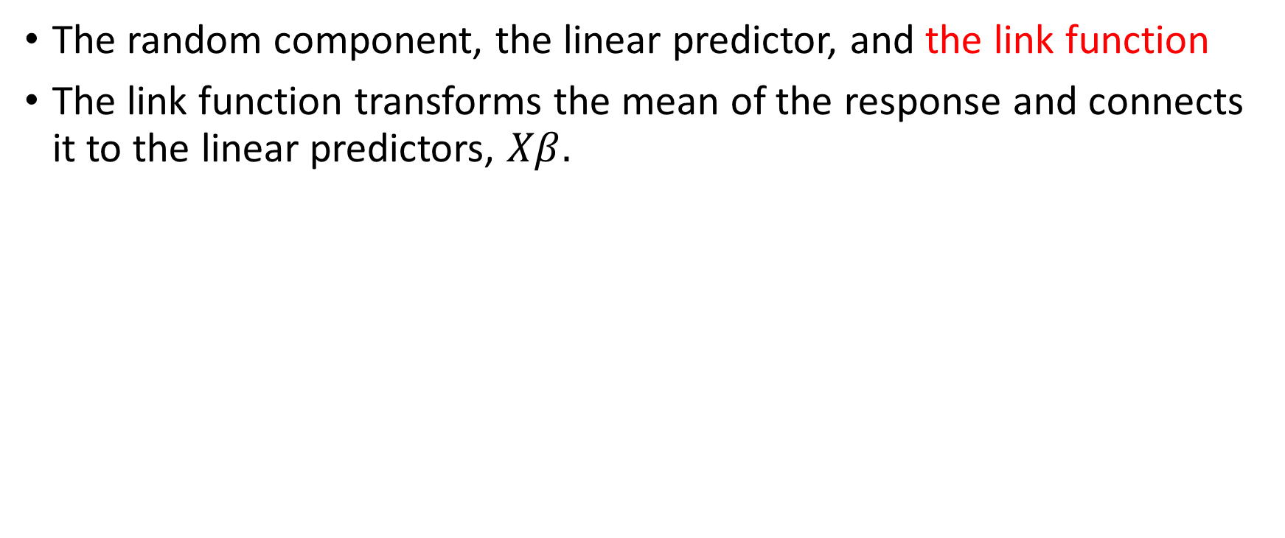
GLM for Poisson data
The random component, the linear predictor, and the link function
The link function transforms the mean of the response and connects it to the linear predictors, $Xβ.$

Slide 24
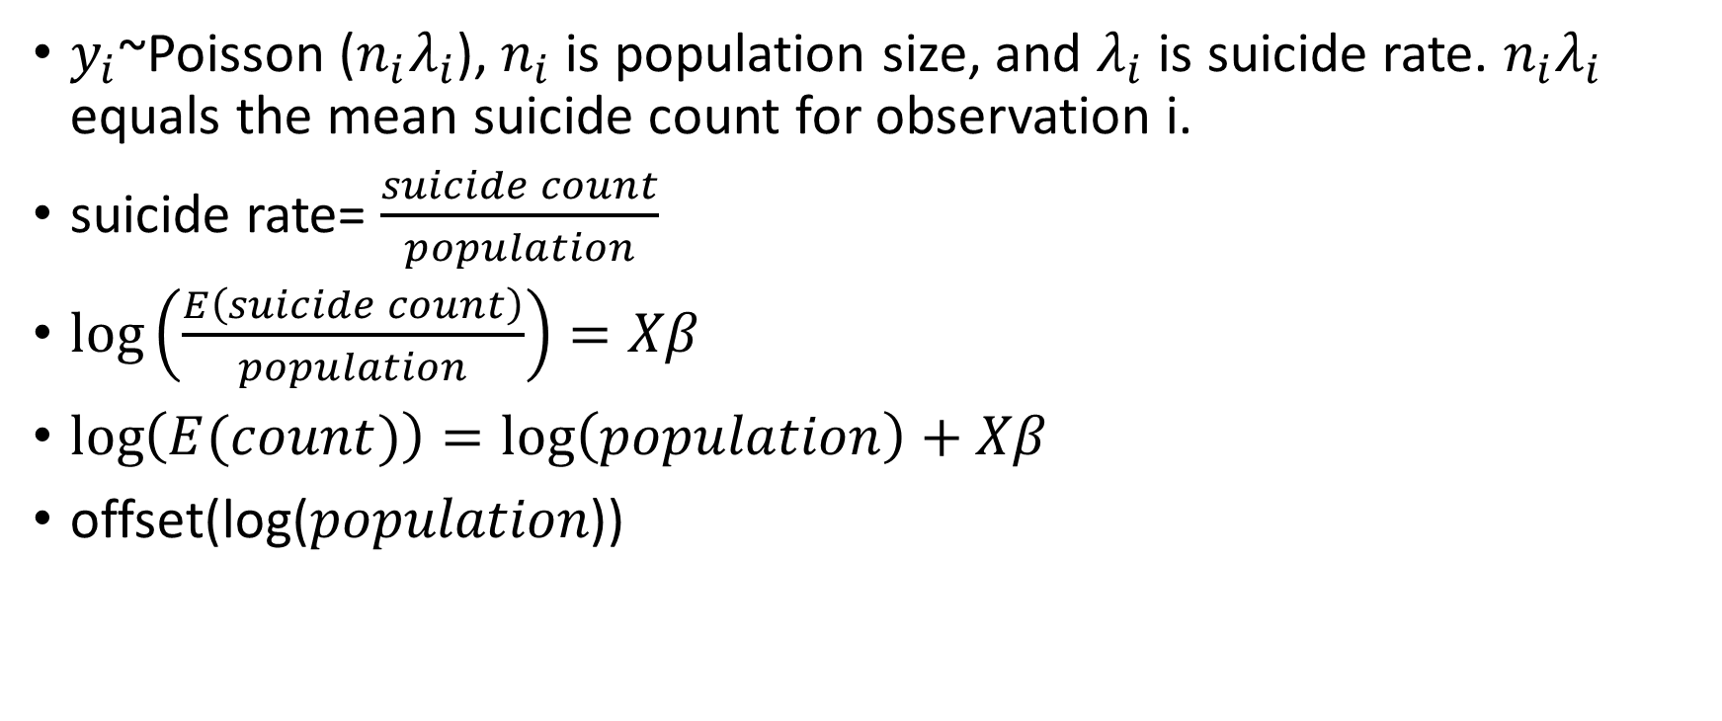
GLM for Poisson data
$y_{i}$~Poisson ($n_{i}λ_{i}$), $n_{i}$ is population size, and $λ_{i}$is suicide rate. $n_{i}λ_{i}$ equals the mean suicide count for observation i.
suicide rate= $\frac{suicide count}{population}$
$\log\left(\frac{E\left(suicide count\right)}{population}\right)=Xβ$
$\log\left(E(count)\right)=\log\left(population\right)+Xβ$
offset(log⁡(𝑝𝑜𝑝𝑢𝑙𝑎𝑡𝑖𝑜𝑛))

Slide 25
Variable selection
---
---------
country, year, sex, age, suicide_no, population, suicides/ 100k pop, county-year, HDI for year, gdp_for_year ($), gdp_per_capita ($), and generation
country*year
AIC, BIC
The model with sex, country * year, log (GDP) was the best.
Analysis of Deviance (ANOD) method. Reduced model with log (GDP); with sex and country; with sex and year; with sex, country, and year the best.
-------
------
---------
------

Slide 26
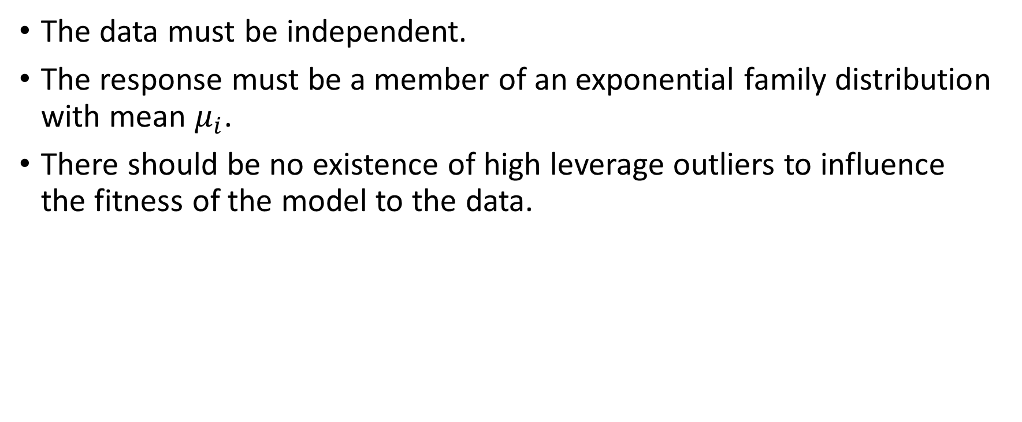
Model and assumptions
The data must be independent.
The response must be a member of an exponential family distribution with mean $μ_{i}$.
There should be no existence of high leverage outliers to influence the fitness of the model to the data.
√

Slide 27
Collinearity
Drop 8 countries: Bosnia and Herzegovina, Cabo Ver, Dominica, Macau, United Arab Emirates, Saint Kitts and Nevis, Saint Vincent and Grenadines, and Mongolia.
Less than 10 years’ data
cor (GDP, year) = 0.2047205. No serious collinearity problem.

Slide 28
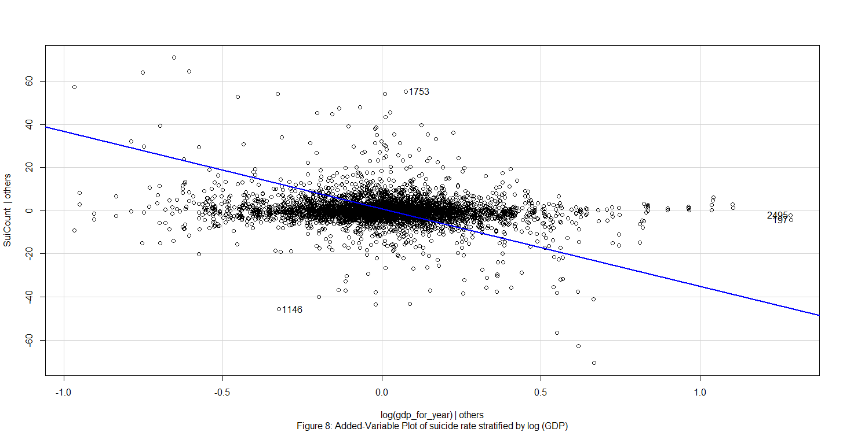
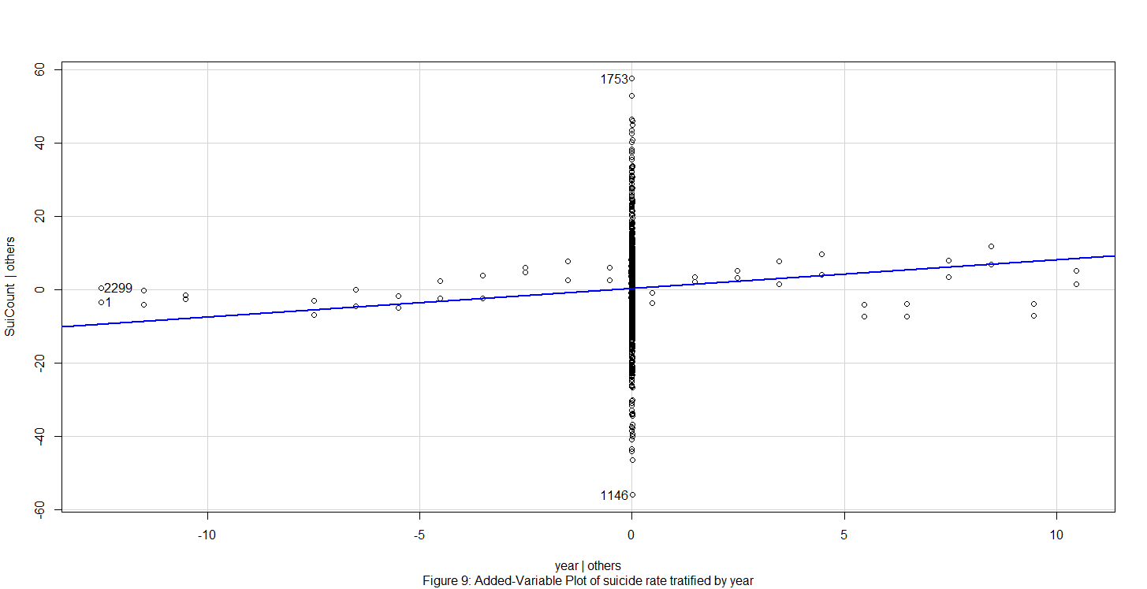
Assumption checking
Added Variable Plots
There is a weak negative relationship between suicide count and the regressors year and log (GDP).

Slide 29
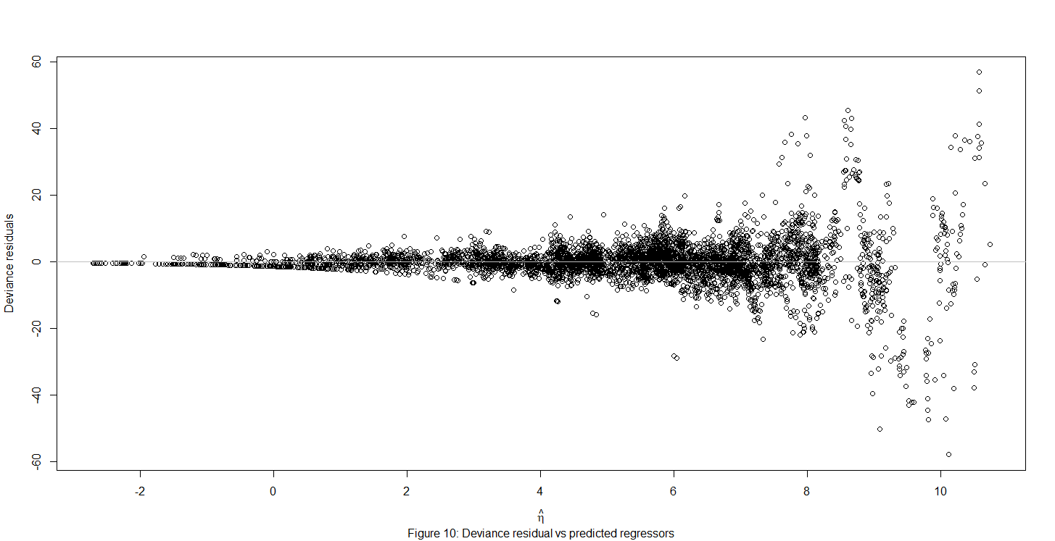
Assumption checking
Residual vs Fitted plot
Non-constant thickness
Poisson model: mean of response = variance

Slide 30
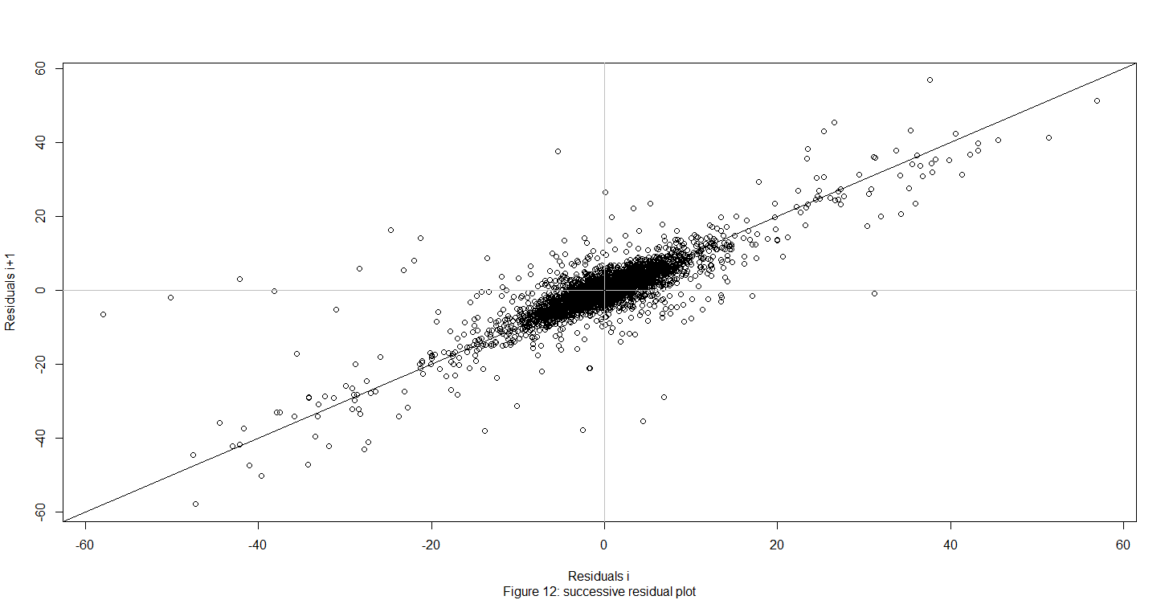
Assumption checking
Successive Residuals Plot
The Durbin-Watson test
Positive serial autocorrelation—1st assumption: data independent
A time-ordered data

Slide 31
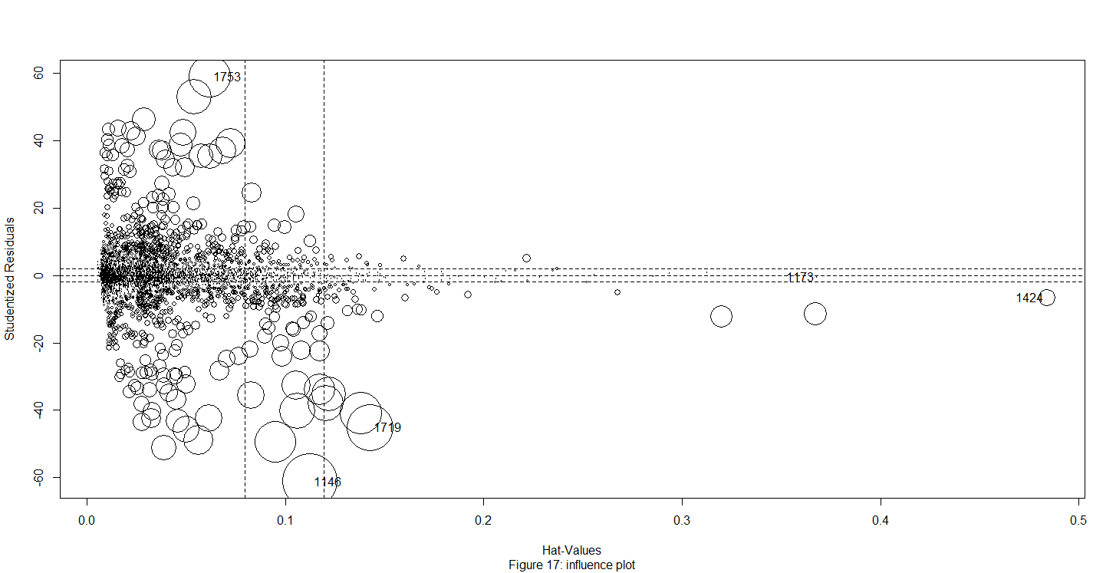
Assumption checking
“Netherlands1990 male”
large hat-value, large leverage
“Kazakhstan1993 male”
large studentized residual, outlier---3rd assumption: high leverage outliers
“Kazakhstan1993 male”, “Romania2003 male”, “Russian Federation2009 male”, “Kiribati1995 male”, and “Netherlands1990 male”
Scale=10

Slide 32
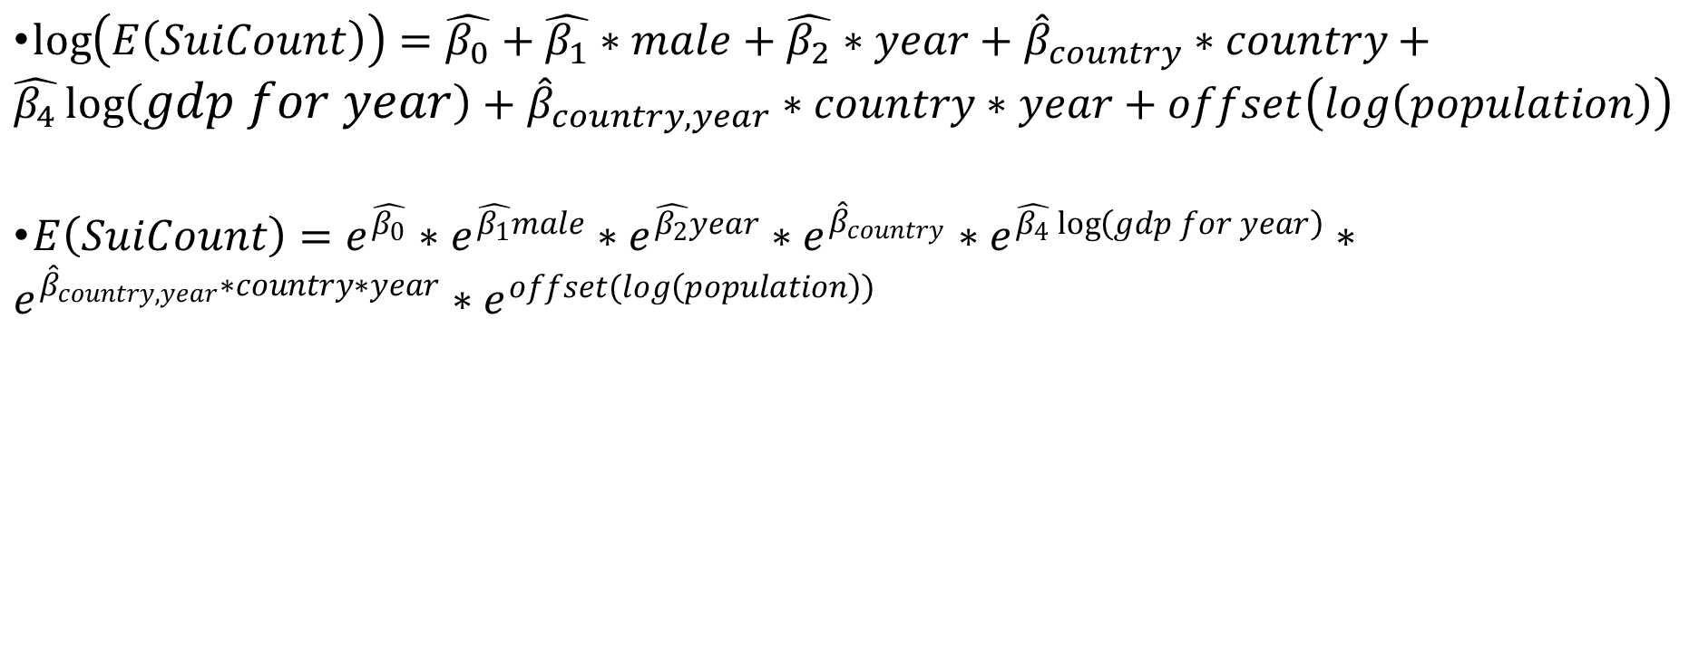
Interpretation and conclusion
$\log\left(E\left(SuiCount\right)\right)=\hat{β_{0}}+\hat{β_{1}}∗male+\hat{β_{2}}∗year+{\hat{β}}_{country}∗country+\hat{β_{4}}\log\left(gdp for year\right)+{\hat{β}}_{country, year}∗country∗year+offset\left(log\left(population\right)\right)$
$E\left(SuiCount\right)=e^{\hat{β_{0}}}∗e^{\hat{β_{1}}male}∗e^{\hat{β_{2}}year}∗e^{{\hat{β}}_{country}}∗e^{\hat{β_{4}}\log\left(gdp for year\right)}∗e^{{\hat{β}}_{country, year}∗country∗year}∗e^{offset(log\left(population\right))}$

Slide 33

Interpretation and conclusion
Males have 3.5644 times of suicide count of females.
Prediction: “males will commit suicide of a rate triple that of females.”
Females tend to have higher rates of reported nonfatal suicidal behaviors, while males have a much higher rate of completed suicides (WHO).
https://www.everydayhealth.com/concussion/how-concussions-affect-males-females-differently/

Slide 34

Interpretation and conclusion
A 1% increase in GDP is associated with a 0.241 % decrease in suicides than the previous year.
Small scale
Prediction: “higher GDP is associated with lower suicide rate.”
Better health care and mental care systems
Sociocultural factors such as unemployment
https://www.moneycrashers.com/gross-domestic-product-gdp-definition/

Slide 35
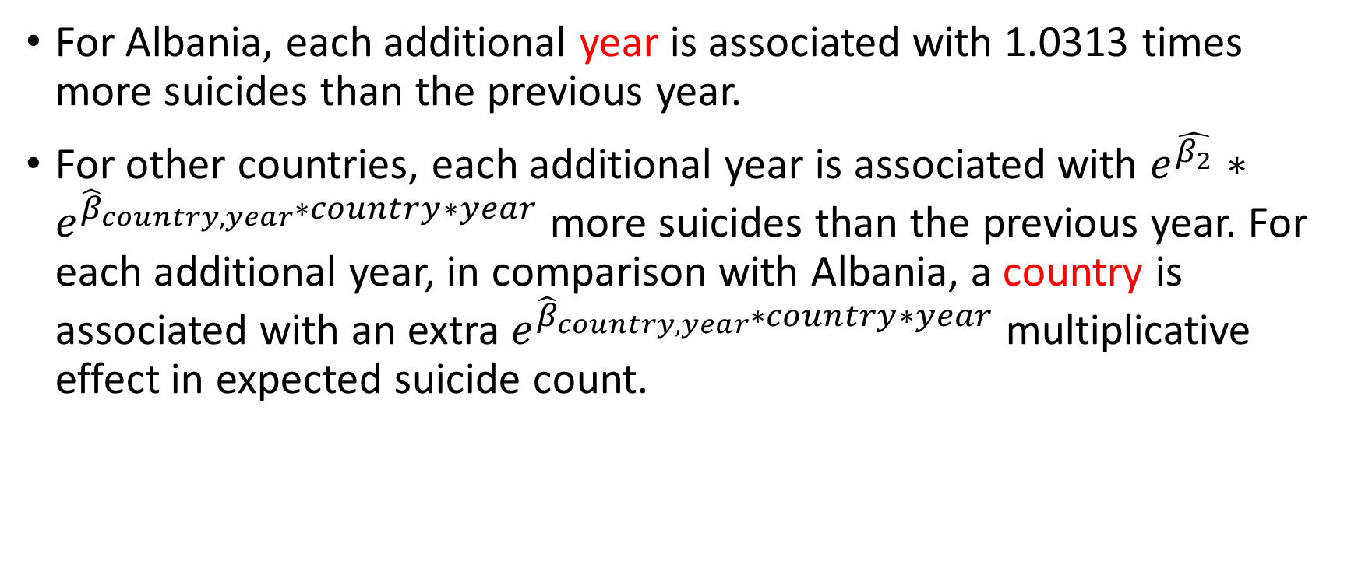
Interpretation and conclusion
For Albania, each additional year is associated with 1.0313 times more suicides than the previous year.
For other countries, each additional year is associated with $e^{\hat{β_{2}}}∗e^{{\hat{β}}_{country, year}∗country∗year}$ more suicides than the previous year. For each additional year, in comparison with Albania, a country is associated with an extra $e^{{\hat{β}}_{country, year}∗country∗year}$ multiplicative effect in expected suicide count.

Slide 36
Interpretation and conclusion
E.g. for Finland, each additional year is associated with 1.0865 times more suicides than the previous year. In comparison to Albania, for Finland, each additional year is associated with 1.0511 times additional effect of change in expected suicide count.
Prediction: “suicide count increase by year.”

Slide 37


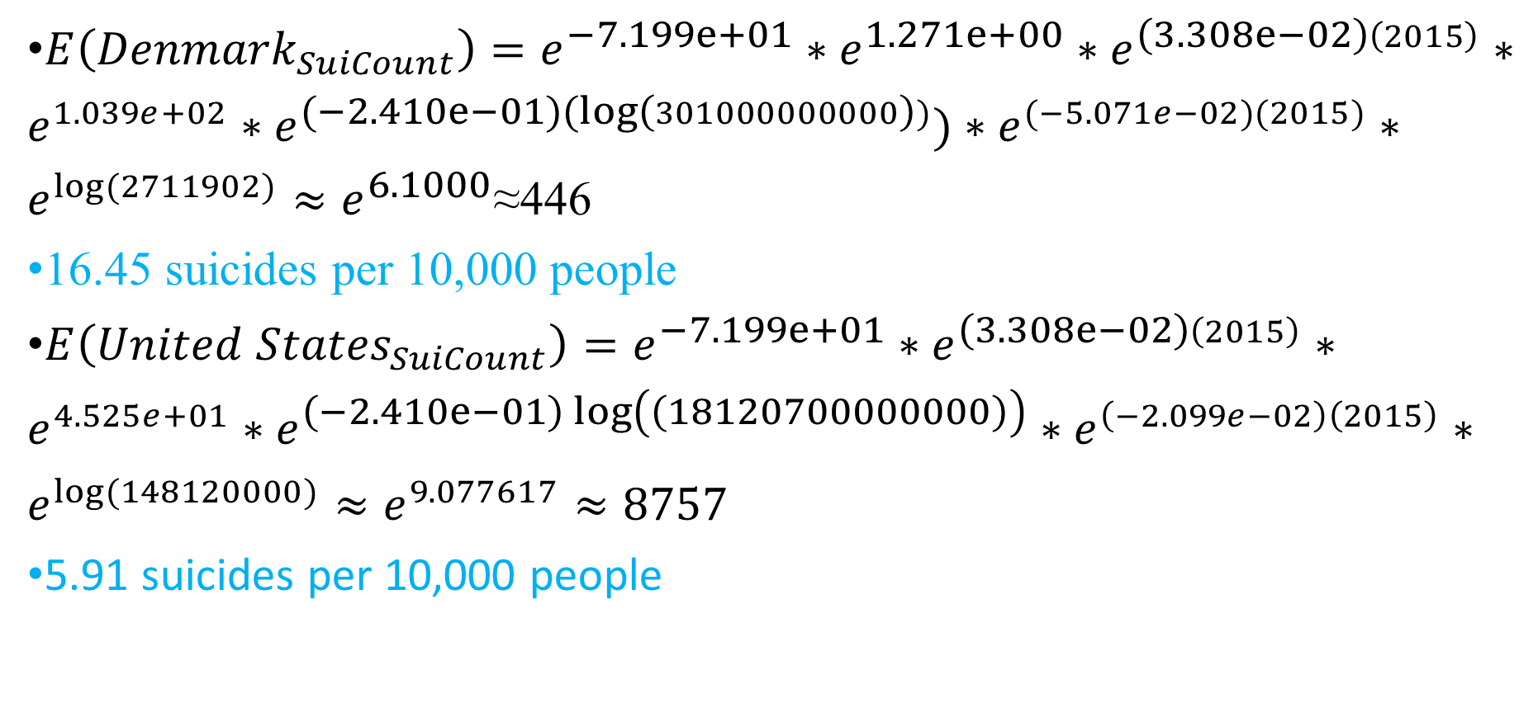
Denmark males in 2015, United States females in 2015
$E\left({Denmark}_{SuiCount}\right)=e^{−7.199e+01}∗e^{1.271e+00}∗e^{\left(3.308e−02\right)\left(2015\right)}∗e^{1.039e+02}∗e^{(−2.410e−01)(\log\left(301000000000\right))})∗e^{(−5.071e−02)(2015)}∗e^{log⁡(2711902)}≈e^{6.1000}$≈446
16.45 suicides per 10,000 people
$E\left({United States}_{SuiCount}\right)=e^{−7.199e+01}∗e^{\left(3.308e−02\right)\left(2015\right)}∗e^{4.525e+01}∗e^{\left(−2.410e−01\right)\log\left(\left(18120700000000\right)\right)}∗e^{\left(−2.099e−02\right)\left(2015\right)}∗e^{log⁡(148120000)}≈e^{9.077617}≈8757$
5.91 suicides per 10,000 people
https://en.wikipedia.org/wiki/Denmark
https://en.wikipedia.org/wiki/Flag_of_the_United_States

Slide 38

Interpretation and conclusion
https://theimpactnews.com/items-we-barely-use/retired-columnists/retro-rewatch/2018/09/13/first-rule-you-dont-talk-about-it/

Slide 39

https://www.youtube.com/watch?v=-DscO3FSoP0

Slide 40

Clinical depression, substance abuse and severe physical disease or infirmity are major causes of committing suicides (WHO).
Prevention, diagnosis, and treatment on committing suicides
Restriction of access to common methods of suicide
https://projectteachny.org/prevention-science/

Slide 41
15-24 years old: school-based interventions
35 to 54 years old: adequate treatment of depression, alcohol and substance abuse
75+ years old: community-based care, identification and treatment of late-life depression (WHO)

Slide 42
Improvement 1
Sex, year, log (GDP), country, country*year
Gini Coefficient
Engel’s Coefficient
HDI
Applicable to most of the observations

Slide 43
Improvement 2
Residuals are autocorrelated in time
Adding more valid numeric predictors
Hard to be eliminated from a time series data.

Slide 44
Improvement 3
Weak relationship between suicide count and regressors including sex, year, and log (GDP).
Suicide count is subject to macro-economic trends, sociocultural condition and many other factors that are different across countries.
Different countries have different patterns of suicide count over years.

Slide 45
References
Faraway, Julian James. Extending the Linear Model with R: Generalized Linear, Mixed Effects and Nonparametric Regression Models, Second Edition. Vol. Second edition, Chapman and Hall/CRC, 2016.
Faraway, Julian James. Linear Models with R. Chapman & Hall/CRC, 2015.
Fountoulakis, Konstantinos N., et al. “Relationship of Suicide Rates to Economic Variables in Europe: 2000–2011.” British Journal of Psychiatry, vol. 205, no. 6, 2014, pp. 486–496., doi:10.1192/bjp.bp.114.147454.
“Poisson Regression for Rates.” RPubs, rpubs.com/kaz_yos/poisson.
Prabhakaran, Selva. “Time Series Analysis.” r-Statistics.co, r-statistics.co/Time-Series-Analysis-With-R.html.
“R: Analysis of Deviance for Generalized Linear Model Fits”, stat.ethz.ch/R-manual/R-devel/library/stats/html/anova.glm.html.
“Residuals in Poisson Regression.” Cross Validated, stats.stackexchange.com/questions/99052/residuals-in-poisson-regression.
Rusty. (2018, December 01). Suicide Rates Overview 1985 to 2016. Retrieved from https://www.kaggle.com/russellyates88/suicide-rates-overview-1985-to-2016/version/1

Slide 46
United Nations Development Program. (2018). Human development index (HDI). Retrieved from http://hdr.undp.org/en/indicators/137506
Värnik, P (March 2012). "Suicide in the world". International Journal of Environmental Research and Public Health. 9 (3): 760–71. doi:10.3390/ijerph9030760. PMC 3367275. PMID 22690161.
World Bank. (2018). World development indicators: GDP (current US$) by country:1985 to 2016. Retrieved from http://databank.worldbank.org/data/source/world-development-indicators#
[Szamil]. (2017). Suicide in the Twenty-First Century [dataset]. Retrieved from https://www.kaggle.com/szamil/suicide-in-the-twenty-first-century/notebook
WHO (2002). "Self-directed violence" (PDF). www.who.int.
World Health Organization. (2018). Suicide prevention. Retrieved from
http://www.who.int/mental_health/suicide-prevention/en/
“6.1 - Introduction to Generalized Linear Models.” 6.1 - Introduction to Generalized Linear Models | STAT 504, newonlinecourses.science.psu.edu/stat504/node/216/.

Slide 47

Q & A
Thank you.

